Slide 1
VA Debt Management Center
(DMC)
School Certifying Official Training
LESSONS LEARNED

Slide 2
DMC Overview
DMC Mission:
Provide distinctive, high quality accounts receivable services through a compassionate and value-added approach, empowering our stakeholders to focus on core missions.
1
DMC is a franchise fund aligned with VA’s Office of Finance (OF) within the Office of Management (OM)
2
DMC’s staff of approximately 300 employees works to service VA benefit debts, counsel Veterans on options and outcomes, and offer resolutions for each unique situation.
3
DMC provides accounts receivable services to VBA, VHA, NCA
4
The DMC collection services collects approximately $1.7 billion annually

Slide 3
Debt Establishment
SCO Certifies Student
RPO Processes Certifications
DMC Collects Debts
Sends collection letters for debts
Sends a letter when payments are issued or debt created
Processes collection actions
Evaluates entitlement
Issues payments and establishes debts
Communicates with student about certification process

Slide 4
Debt Establishment - Institutions
January 4, 2021 and Previous
Student never attended
Student completely withdraws on or before the first day of the term
Student passed away during or before the term
School received payment for the wrong student
School received a duplicate payment
Amended certification with reduced tuition, fees and/or Yellow Ribbon
Payment issued for wrong amount
January 5, 2021 and Forward
Schools are financially responsible for benefits paid under the Post 9/11 GI Bill:
Tuition and fees
Yellow Ribbon Program.

Slide 5
Debt Establishment- Students
January 4, 2021 and Previous
Books and Supplies
Housing Stipend
Tuition and fees
Withdrawals during the term
Reductions
Terminations
January 5, 2021 and Forward
Books and Supplies
Housing Stipend
Notes:
.

Slide 6
Public Law 116-315 Section 1019
Education Regional Processing Offices (RPOs) will do the conversions from student to institution debt, for debts created on or after January 5, 2021
Debts created on or before January 4, 2021 will not be changed
After conversion, normal Debt Management Center (DMC) processes will apply
Debt letters from DMC to the school
Debts will show on debt lists requested by facility code
Notes:
.

Slide 7
Public Law 116-315 Section 1019
Institutions should not attempt to submit payment, until they have been notified through DMC letter that the debt is established for the institution/school
Collection on student debts is currently paused
- COVID relief for students with debts created after April 1, 2020 has been extended until September 30, 2021

Slide 8
COVID-19 Relief
COVID relief for students with debts created after April 1, 2020 has been extended until September 30, 2021
Institutions (schools) continue to receive the normal series of debt letters
No referral to Credit Reporting Agencies or Credit Alert Interactive Voice Response System (CAIVRS). CAIVRS alerts lenders of VA debt and impacts federal home loan underwriting
All collection action on VA debts under the jurisdiction of the U.S. Department of the Treasury is suspended until September 30, 2021

Slide 9
COVID-19 Relief
Options for Veterans with pre-existing debts (created before April 1, 2020) who are experiencing financial hardship due to COVID-19:
Pause benefit offset or payments due until October 1, 2021
Extend repayment plan terms

Slide 10
Outreach and Updates
VSO, SCO and Veteran emails
VA texts and social media
Borne the Battle Podcast
Press releases

Slide 11
New Debt Portal for Veterans
Debt Portal: https://www.va.gov/manage-va-debt/
Veterans can log in to view balances and DMC letters
FAQ’s
More enhancements to come
DMC website: https://www.va.gov/debtman is still operational

Slide 12
Collection Process
DMC sends Notice of Indebtedness letters, monitors accounts, and advises debtor of any delinquency, including the requirement to refer their account to Treasury
DMC Sends 1st Letter
30 days
DMC Sends 2nd Letter
30 days
DMC Sends 3rd Letter
60 days
Debt is Referred to Treasury (120 days)
If DMC receives payment, next collection letter is deferred

Slide 13
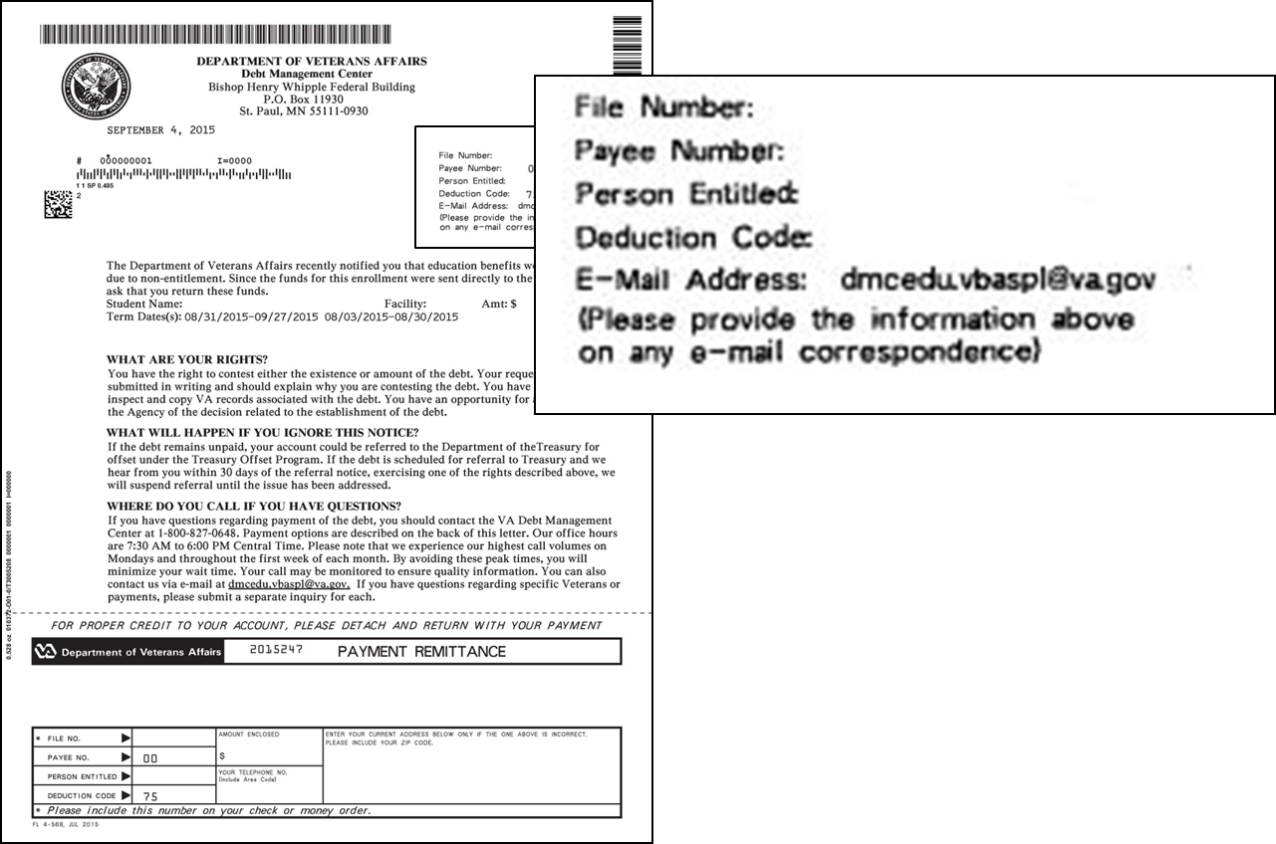
Notification Letters

Slide 14
School Options
School Options
Pay in Full
Dispute
Compromise
Payment Plan

Slide 15
Tips for School Inquiries
When emailing disputes and inquiries, please include:
One email per student
First initial, middle initial, last name
Last four of SSN
School name and facility code
Debt amount
Supporting details (front and back of cashed check, when was updated certification sent, etc.)

Slide 16
Student Options
Student Options
Pay in Full
Reduced Benefit Offset
Dispute
Waiver
Compromise
Payment Plan

Slide 17
How to Pay a Debt
Pay by check: mail the check, payment coupon(s) and/or letter to:
VA Debt Management Center
Bishop Henry Whipple Federal Building
P.O. Box 11930
St. Paul, MN 55111-0930
Pay online: www.pay.va.gov
Check SCO handbook for other options
Payments from schools for student debts must include either:
The remittance stub for the student debt (preferred)
A letter specifically stating the school wants to pay the student debt

Slide 18
Treasury Overview Debt Collection Tools
Treasury has two main programs for student and school debt collection
Treasury Offset Program (TOP)
Cross-Servicing (CS)
Federal grants
Social Security
Civilian pay
Military retirement
Private Collections Agencies (PCA)
Telephone collections
Administrative Wage Garnishment (AWG)

Slide 19
How to Contact TOP
Schools may contact TOP by calling the TOP Call Center:
1-800-304-3107
In order to provide you with information about an offset, Treasury will need to know:
The caller’s name, department and job title. The job title will need to indicate a need-to-know position.
At least one of the following:
date of the payment
amount of the original payment
amount of the offset

Slide 20
Become a Debt Superstar (Contact DMC)
www.va.gov/debtman
800-827-0648
https://iris.custhelp.va.gov/app/ask/
dmcedu.vbaspl@va.gov
(Schools only)
https://www.va.gov/manage-va-debt/
Veteran Debt Portal

Slide 21
Issue Not Getting Resolved?
Julie Lawrence – Chief Education and External Relations
Julie.Lawrence@va.gov
Nicole Haselberger – Assistant Chief Education and External Relations
Nicole.Haselberger@va.gov
Tami Dorle – Supervisory Financial Administrative Specialist
Tamara.Dorle@va.gov
Gary Greenwood – Management Analyst
Gary.Greenwood2@va.gov

Slide 22
DMC Presentation Survey
DMC values your time and feedback on our presentation. We would appreciate it if you’re able to complete the survey below.
https://www.surveymonkey.com/r/XF3PLGN

