Slide 1
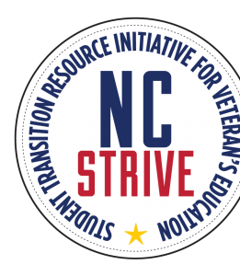
NC STRIVE (Student Transition Resource Initiative for Veteran’s Education) Goal: To share best practices to better serve our nation’s veterans, service members, and their family members in seeking higher education
Siobhan R. Norris, snorris4@uncfsu.edu
Associate Vice Chancellor for Military Affairs
Fayetteville State University
https://strive.ncgwg.org/
Notes:
NC STRIVE grew out of a challenge from Dr. Chad Kessler, formerly the Deputy COS in Durham, to expand outreach efforts to all two- and four-year campuses in North Carolina. STRIVE was built in part upon our experience working with NC State (including the Raleigh Vet Center – NCSU collaboration to provide psychotherapy on campus) and successful outreach partnerships with Duke and UNC-Chapel Hill. The initial task was creating a large group with involved stakeholders from the VA, state government, and the education community. The Governor’s Working Group became a part of the success of this effort.

Slide 2
What is NC STRIVE?
NC Governors Institute/NC Governors Working Group
PURPOSE: Annual conferences aimed to equip administrators, faculty and staff in higher education with information, resources, and networking that will enhance the experience and success of student Veterans in their pursuit of certificates and degrees.

Slide 3
Governor's Working group ON VETERANS, SERVICE MEMBERS, AND THEIR FAMILIES
Mission: In 2006, an intra-governmental Working Group was established, focusing on health and wellness, job creation, workforce enrichment, legal and financial services, and benefits for Veterans. Over the years, this coalition has evolved into a referral and collaboration network that gets Veterans and their families the services and supports that they need and reduces red tape.­­ Governor Cooper is supportive of the initiatives undertaken by the Working Group.
Vision: The North Carolina Governor’s Working Group [NCGWG] is charged with facilitating collaboration and coordination among ALL Federal, state and local agency partners that touch a Veteran’s life in the state of North Carolina. In short, the “Working Group” is making government work for our Veterans, Service Members, and their families.

Slide 4
Key partnerships
Spreading the Work and Knowledge
1 Steering Committee covering the State of NC
4 Regions with their own Planning Committee
Community Colleges, Public and Private Universities, and other stakeholders
Behavioral Health Topics in All Regions

Slide 5
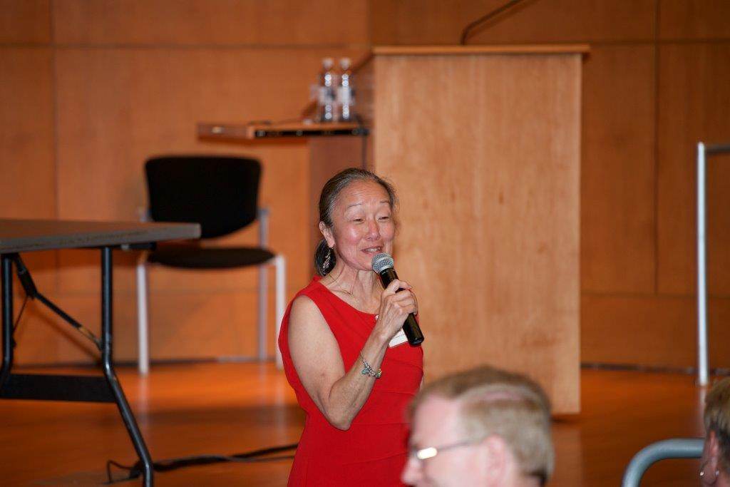
Supporting the Successful Transition of Military Veterans
Bringing People Together
Sharing a Vision for this Project
Supporting Regional Leadership to Define the Content
Sharing Best Practices

Slide 8
North Carolina Department of health AND human services (Ncdhhs)
The Department of Health and Human Services manages the delivery of health- and human-related services for all North Carolinians, especially our most vulnerable citizens – children, elderly, disabled, and low-income families. The Department works closely with health care professionals, community leaders, and advocacy groups; local, state, and federal entities; and many other stakeholders to make this happen.

Slide 9
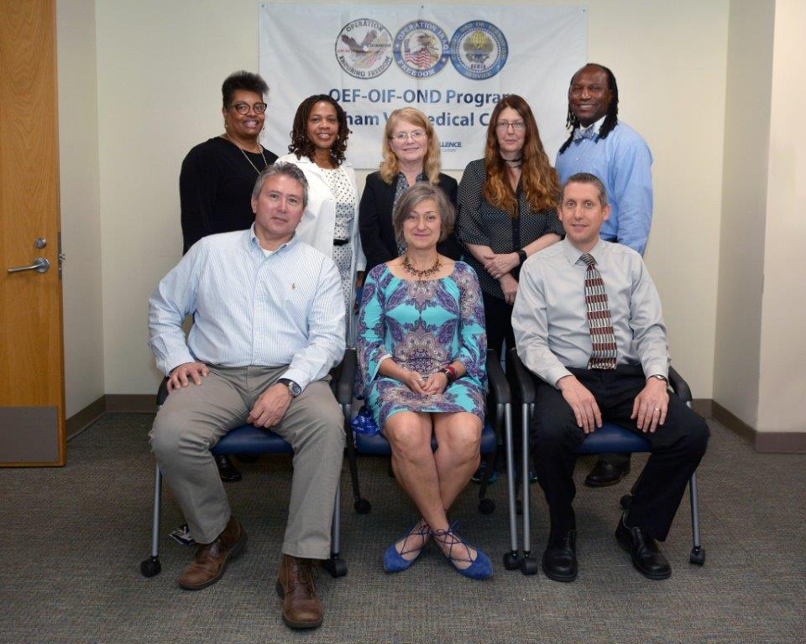
VHA Partnership: Health care for veterans
At EVERY VA there is a Post 9/11 Military to VA (M2VA) Case Management Program designed to expand awareness of eligibilities, support access to care, and provide excellent customer service.
CARE VETERANS HAVE EARNED
Supporting NC STRIVE since its inception in 2014.

Slide 10
GOING VIRTUALGO EFFORTS TO BECOME VIRTUAL
Three regional conferences for 2020 were canceled
NC STRIVE went virtual in May 2020
9, 476 viewers!!!

Slide 11
2021 Virtual events
Number of Viewers
February 24, Transition 3,233
March 30, Employment 6.009
April 29, Wellness and Whole Health 533
May 6, Education 1,733
TOTAL 11,508

Slide 12
NC STRIVE: 2019 Survey (396 STUDENT VETERAN RESPONDENTS)
Top services provided by institutions of higher education:
214 Veterans services and supports
204 Admission process
171 GI Bill benefits explanation
What is lacking at schools:
115 Veterans peer mentors/coaches
103 Veteran-specific events
What faculty and staff need to know about student Veterans:
204 Transitional support issues
178 Treatment of mental health issues (e.g., depression, anxiety, post-traumatic stress disorder)
156 Local, state, and federal resources and services for Veterans

Slide 13
Why this is important to our schools
Schools focusing on Veteran Centric Educational Programs are expanding across the state
These Veterans have earned educational dollars and are using it locally
Helping Veterans succeed at your schools improves the institution’s reputation
Well educated Veterans with families are likely to stay in NC.
Keeping these opportunities here in the state benefits us all
Notes:
Why do we need to understand how we are supporting our military students? Tie it back to Joe’s data on $12B in taxpayer dollars; Military are more likely to invest in their communities (owning a home, voting, paying taxes, giving back to the community, starting businesses and growing the economy, etc., and are more likely to give back to their alma matters).

Slide 14
What does your leadership need to know
Veterans need your focus
How you can help
What is lacking at schools:
Veterans peer mentors/coaches
Veteran-specific events/resources
What faculty and staff need to know about student Veterans:
Veterans want Transitional support
Veterans do have issues with Transitions
Veterans may need accommodations for MH and other concerns

Slide 15
Desired: Leadership participation
Today’s leaders must have the skills not only to motivate change, but also to eloquently articulate it for diverse audiences. This requires that leaders have an authentic and consistent relationship with stakeholders. The dialogue must be ongoing and collaborative. This may be old news in a sense, but the context is new. The academy values tradition, but our world values change. How a leader manages the juxtaposition of tradition against the backdrop of change is critical.
We need the leadership of the school, the faculty, and deans to support the VISION of a Veteran Centric Campus

Slide 17
2022 NC STRIVE @ FSU
Green Zone Training & Military Cultural Competency
Supporting HBCUs and MSIs Serving Military Connected Students
Mental Health Support
Adult Learner Resources
Military Student Panel
Employer Best-Practices Panel

Slide 18
Sarah Plummer Taylor

Slide 20
All are welcome!
We encourage institutional leadership to support NC STRIVE events.
It is vital that schools with large numbers of student Veterans be represented and prepared to support our Veterans.
In 2019, the latest year that data are available for the number of student Veterans and military-connected dependents on the GI Bill in North Carolina, 13,297 were in community colleges, 11,437 were in the University of North Carolina System, and 4,558 were in NCICU (NC Independent Colleges and Universities)-affiliated schools.

Slide 21
Thank you

