Slide 1
A New Model for Higher Education Quality Assurance: An Overview of the GI Bill® Risk-Based Review Pilot Dr. Joe Wescott Legislative Liaison, NASAA National Risk-Based Survey Project Director

Slide 2
How We Got Here – Need For Risk-Based Surveys
Advocates and government watchdogs were concerned that the VA “compliance survey” did not prioritize SAA/VA resources and was not comprehensive enough.
Concerns included failure to prioritize facilities: under investigation by federal and state regulators; engaged in misleading or deceptive recruiting practices; where student complaints indicated problems; not financially stable and facing collapse and closure.
Congress passed the Harry W. Colmery Veterans Educational Assistance Act of 2017, known as the Colmery Act.
Requires that State approving agencies evaluate the risk posed by currently GI Bill® approved schools by conducting risk-based surveys (RBS).
Notes:
Increase in misleading and deceptive recruiting practices specifically target at veterans, often by high-cost programs at schools that do not always lead to good outcomes or earning for veterans and their families
Concerns from advocates and government watchdogs that the current process was insufficient and did not prioritize SAA/VA resources toward riskiest institution
The terms of the contract and present guidance by VA allows little focus on program quality or student outcomes and focuses primarily on payment accuracy during compliance surveys.
Specific concerns were raised and included the failure to prioritize schools that were under investigation by federal and state regulators, where schools were engaged in misleading or deceptive recruiting practices, where student complaints indicated problems, or where schools were not financially stable and faced of collapse and closure.
In response, in 2017, Congress passed the Harry W. Colmery Veterans Educational Assistance Act of 2017 ,known as the Colmery Act, which for the first time required SAAs to evaluate the risk of these programs
Recognizing that “compliance surveys” were insufficient to address the widespread use of misleading and deceptive tactics, the Colmery Act required for the first time that state approving agencies evaluate the risk that schools approved to disburse GI Bill funds pose to students and taxpayers.

Slide 3
Who This Work Impacts – Student Veterans and Taxpayers
Taxpayers invested $12 billion in educating and supporting student veterans in FY2019
18% of that money funds education for family members of eligible veterans
Enrollment in college using veteran education benefits totaled nearly one million students in FY2019
Military education benefits have increased and now total $14.3 billion per year

Slide 4
Dangers to Students From Risky Schools
Large schools closing without warning have made big headlines the past several years—but schools can harm students in less obvious ways:
More than half of institutions left the majority of their students earning less than $28,000—the typical salary of a high school graduate.
More than 1,800 institutions graduate less than 50% of their students, even after eight years.
Some are particularly low-performing: More than 500 institutions leave 75% of students without any certificate or degree.

Slide 5
The State Approving Agencies
State Approving Agencies (SAAs) are responsible for the review and approval of higher education institutions.
SAAs are state agencies that operate under contract with VA to oversee schools through compliance surveys
Concerns from advocates and some in the VA on effectiveness of these surveys
The Colmery Act in 2017 instituted risk-based reviews, but limited progress was made in the following years
Johnny Isakson and David P. Roe, M.D. Veterans Health Care and Benefits Improvement Act of 2020 passed at the end of the Trump Administration integrated key elements into federal law. Set the bar for Risk Based Surveys.

Slide 6
Where We Are At and Where We Are Going
Progress/need recognized by Congress in a new statute
Johnny Isakson and David P. Roe, M.D. Veterans Health Care and Benefits Improvement Act of 2020 passed at the end of the Trump Administration
The Secretary and the SAAs must work in partnership to develop a risk-based survey (RBS)
SAAs required under law to no longer conduct compliance surveys, just risk- based reviews, effective October 2022; the pilot model and data evaluated fully comply with new statutory requirements
The Future of GI Bill Approved Institutions: Risk-Based Surveys
Notes:
Joe W:
This progress has not been lost on relevant Hill staff, which decided to memorialize key portions of the risk-based reviews into new statutory Congress
Johnny Isakson and David P. Roe, M.D. Veterans Health Care and Benefits Improvement Act of 2020 passed at the end of the Trump Administration. This provided further guidance and enumerated factors that should be reviewed to identify risky schools during a risk-based survey.
This bill makes clear that the Secretary the SAAs must work in partnership to develop a risk-based survey (RBS) and develop a shared database with the information accessible to VA and the SAAs.
It also makes clear that failure to cooperate with an SAA’s request for information is grounds for disapproval.
We are prepared to help them with and maximize the chances of success
We would get additional feedback, evidence, findings about particular schools, be able to better coordinate on multi-state institutions, coordinate with other state regulatory bodies, make referrals to other regulators of findings, etc.
Key work from advocates: VES, American Legion, NASAA
Scaling Nationally
Recent congressional hearing: VA’s support
If there is a question on Roe Isakson:
Requires that the Secretary of the Veterans Administration (VA) and the State Approving Agencies (SAAs) in partnership develop a risk-based survey for oversight of schools.
Clarifies that failure to cooperate with an SAA’s request for information is grounds for disapproval.
Requires that SAAs conduct a risk-based survey within 60 days when a school is subject to action by other regulators (accreditors, state oversight agencies, Department of Education, FTC, CFPB, SEC).
Requires that a risk-based surveys examine at a minimum: increases in veteran enrollment and cost, complaints, financial stability, advertising and recruiting practices, lawsuits and investigations, and compliance with the 85/15 requirement.
Clarifies that any approved school that engages in misrepresentation (as defined in the Department of Education regulations); makes more than 3 unsolicited contacts within a month; engages in same day recruitment and registration; or is subject to negative action by an accreditor is subject to sanction and potentially disapproval.

Slide 7
Pilot SAAs and Advisory Council
Who are the voices of the Advisory Council?
Veteran Advocate Groups
Student Advocate Groups
Accreditors
State Authorizers
Institutional Leaders
Policy Advocates
SAAs
SAA Pilot States

Slide 8
Need for Risk-based Quality Assurance System
Review recruiting tactics and student concerns
Review financial stability
Acknowledge that some schools pose less risk than others
Consider the probability and impact of the potential risk
Create incentives to improve and address identified risks
Project Goals:
Use meaningful metrics to identify risks in order to make sure veterans are well served, and to safeguard taxpayer funds
Conduct data-based comprehensive and veteran-centric site visits
Build relationships with federal and state regulators and accreditors
Create a consistent national oversight model

Slide 9
Pilot Model: Risk Based Filter
The risk assessment process and the review seek to consider both the probability and the impact of the potential risk to students and taxpayers
The risk filter is a system that separates low-risk schools from high-risk schools using quantitative publicly available measures
Based on the performance on those selected indicators, approved facilities are categorized into one of three risk tiers: Priority 1, 2, or 3.
Priority 1
High Risk
All Eligible
GI Bill® Programs
RISK BASED FILTER
Automated Process and Risk Designation
Priority 2
Medium Risk
Priority 3
Low Risk
Note: The metrics used to assess the risk level of a school in a risk filter are not, by themselves, grounds for action by an SAA against a school.
Notes:
Risk based filter to Identify High Risk Schools and Allocate Resources
Veteran specific metrics are not always easily available, it is possible to access these metrics for the total student population. While these factors can likely be used in a risk screen to identify programs at risk, additional Colmery factors may work more effectively during a deeper review following the risk-based filter (a “risk-based review”).

Slide 10
Developing the Risk-Based Filter

Slide 11
Pilot Model:
Developing Risk-Based Filter
Compile available data for all facilities under SAA jurisdiction
Publicly available metrics
SAA-provided metrics
Enrollment change over one and two years
Veteran enrollment
Tuition change over one and two years
Average total net price to students
Total complaints reported to the VA
Heightened Cash Monitoring status
Three-year cohort default rate
Completion rate - total and disaggregated by student group
(With comparisons by Pell recipients and for Black and Latino students)
Full- and part-time retention rate
Ratio of graduate earnings to state high school graduate earnings
Percent of revenue spent on instruction
Multi-state facilities
Newly approved facilities
Recent change of ownership
Recent expanded audit or training by SAA
Recent suspension
Recent withdrawal

Slide 12
Pilot Model:
Developing the Risk-Based Filter
Steps In Between the Process
Step 2
Determine descriptive statistics for each indicator
Step 3
Assign each school a risk score within each metric
Step 4
Sum risk scores across all metrics and calculate a cumulative risk score for each institution
Step 5
Calculate distribution of cumulative risk scores (standard deviation and z-scores)

Slide 13
Pilot Model:
Developing the Risk-Based Filter
Use state distribution of outcomes to determine thresholds and assign priority levels (1, 2, or 3)
Priority Level | Cutoff Risk Score
Priority 1 | 3.7
Priority 2 | 2.1
Priority 3 | 1.2
School | Risk Score | Priority Level
A | 5.0 | Priority 1
B | 0.5 | Priority 3
C | 3.5 | Priority 2
D | 2.0 | Priority 2

Slide 14
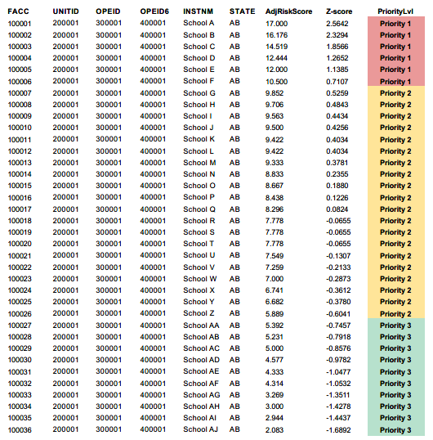
Pilot Model:
Risk-Based Filter Overview Example
Mean | 8.007
Median | 7.778
StdDev | 3.507
 | Count | Pct
Priority 1 | 6 | 16.67%
Priority 2 | 20 | 55.56%
Priority 3 | 10 | 27.78%

Slide 15
Pilot Model: Site Review of Risky Schools
Additional Private Data Requests
Report open state, federal, or authorizing entity investigations
GI bill® recipient complaints
Financial records, advertising, transcripts
Separate schools into three priority levels based on risk screen using public data
For selected schools, SAA sends request for data and documents in advance to prepare for site review
Site visit includes classroom observation, student interviews, and inquiries based on pre-visit data review
Summary to the facility, report to VA and referrals made to affiliated agencies
Priority 1
Additional Steps
All schools are reviewed deeper
Request for further documentation
Site visit is scheduled
Deeper Risk Based Review
Additional Private Data Requests
Report open state, federal, or authorizing entity investigations
GI bill recipient complaints and financial information
Priority 2
Additional Steps
Random sample of 25% of these programs are reviewed
Request for further documentation
Propose site visit if necessary
Review As Needed
Additional Steps
Random sample of 5% of these programs reviewed
Request for further documentation
Priority 3

Slide 16
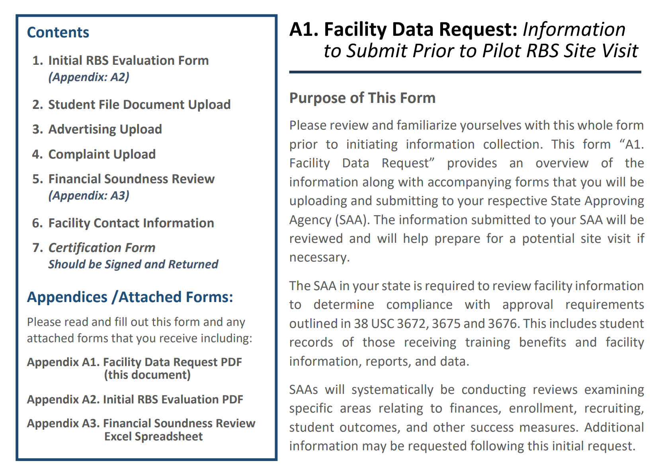
Pilot Model: Data and Document Request
Each school identified was asked to provide a set of materials.
Documents requested included: Advertisements and recruiting materials; student complaints, financials, 90/10 and 85/15 compliance, and pending investigations.
SAAs then evaluated the data and prepared for the site visit focusing on the issues identified.

Slide 17
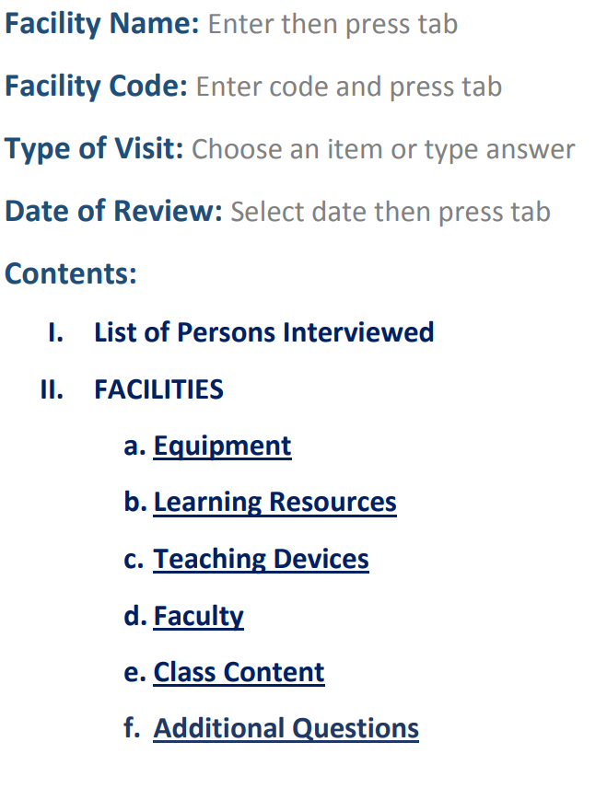
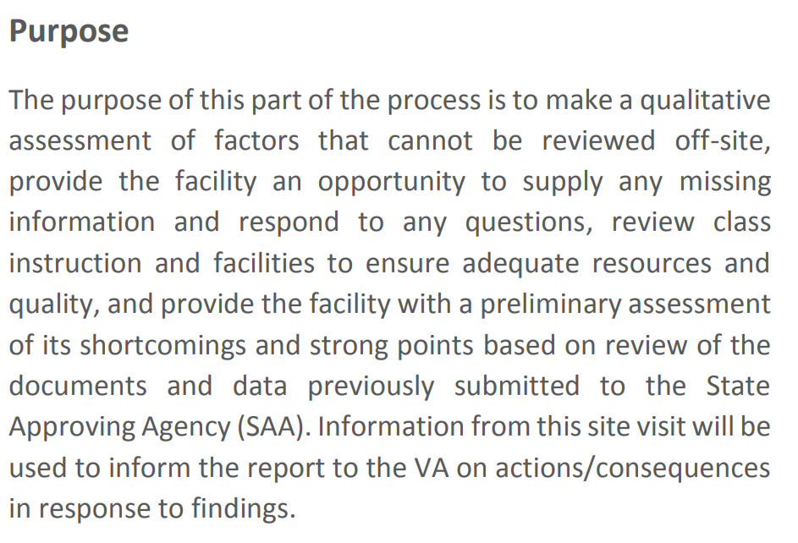
Pilot Model: Site Visit
SAAs tour the facility, observe classroom instruction, interview students, and make inquiries of relevant staff based on pre-visit data reviewed.
SAAs then make a qualitative assessment of factors that cannot be reviewed off-site

Slide 18
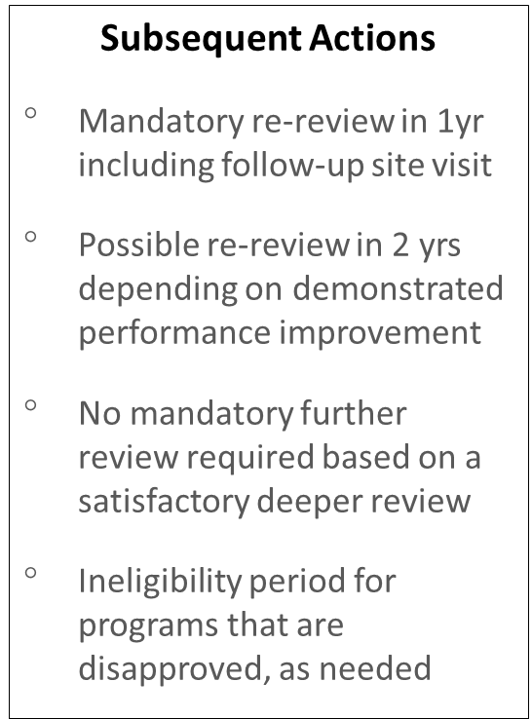
Pilot Model: Consequences & Subsequent Actions
Some reviews will find the initial risk factors were not actually indicative of heightened risk and no reason for corrective action is warranted.
Other reviews, however, will find academic shortcomings, financial noncompliance, or deceptive recruiting practices that may rise to the level of a substantial misrepresentation.
Potential Consequences
Mandatory School Official Training
Require demonstration of improved performance on specified metrics within particular timeframe
Program Suspension (i.e. disapprove New GI Bill® Enrollments)
Withdrawal of Program (i.e. discontinue all GI Bill Payments)
Continuation of GI Bill participation pending no further detrimental performance
No corrective action required based on satisfactory SAA review
Notes:
This was a pilot and it was not our priority to impose new consequences or actions but we did establish a referral process to refer findings identified
Depending on the findings of the deeper review, various types of consequences may be justified and carried out by the SAA.
Some reviews will find the initial risk factors were not actually indicative of heightened risk and no reason for corrective action is warranted.
Other reviews, however, will find academic shortcomings, financial noncompliance, or other harmful behaviors that necessitate action on the part of the SAA.
Some reviews will find the initial risk factors were not actually indicative of heightened risk and no reason for corrective action is warranted.
Some problems discovered by SAAs in a given review year may not be quickly resolvable.
Other problems may be resolved but the SAA still has sufficient concerns about the abilities and capacity of the program that a subsequent year review is needed.
Other requirements or actions required for proof of improvement and follow-up as needed.
Even though these are potential consequences

Slide 19
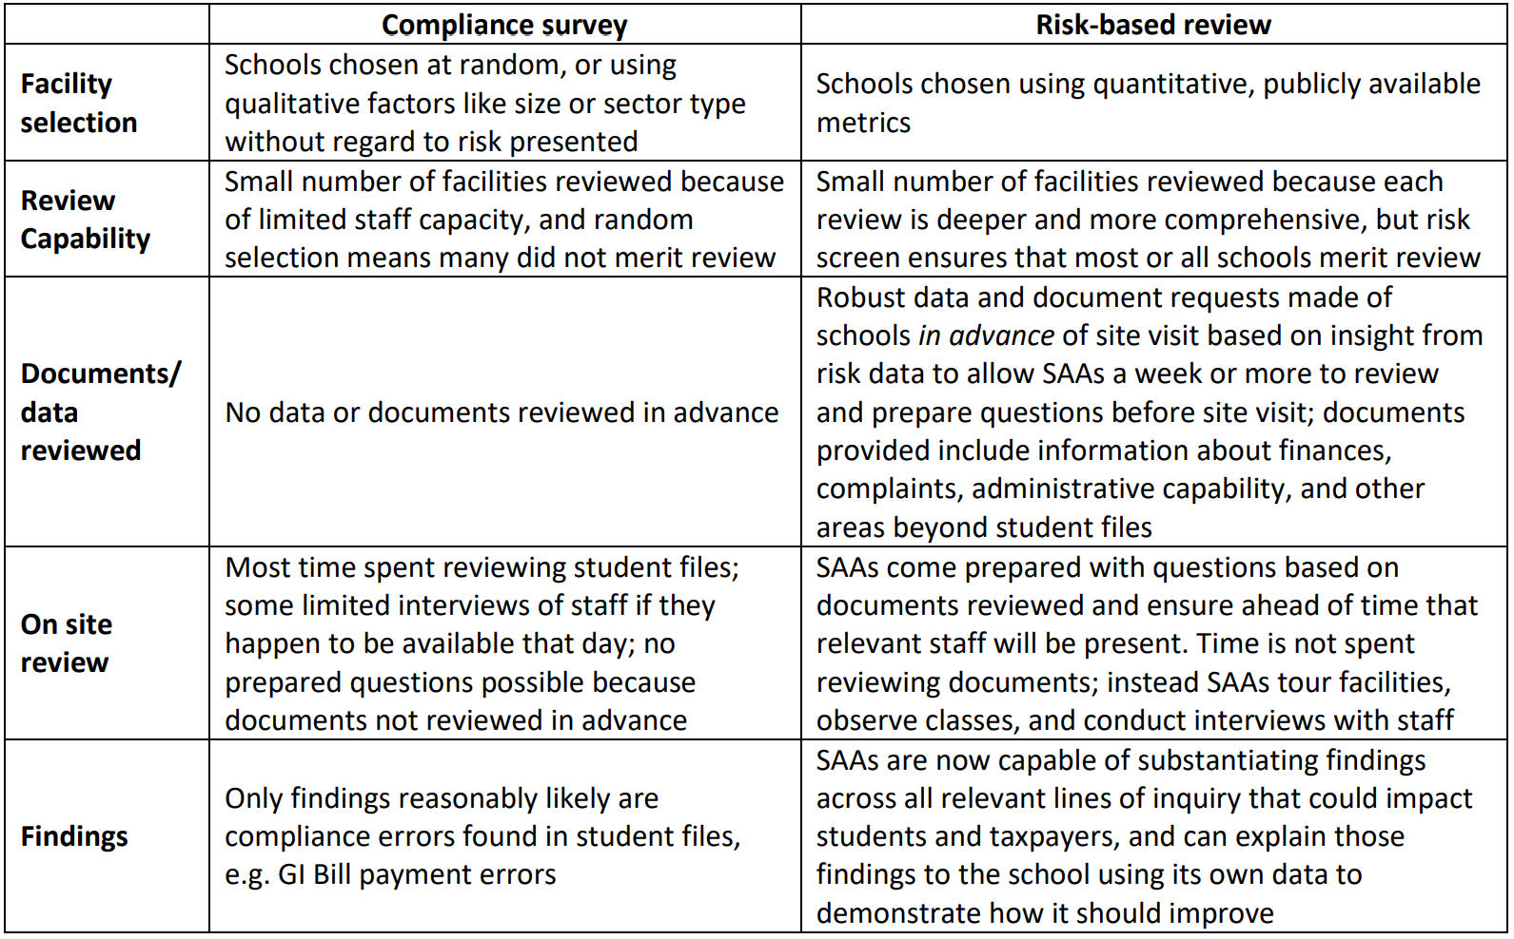
Comparing Compliance to Risk-based, Outcomes-focused Reviews
This approach identifies areas of concern that directly impact student veterans’ ability to complete programs and increase their earnings and provides a more effective process to judge if a school is posing a financial risk to both veterans and taxpayers.
Notes:
Key takeaway: This approach identifies areas of concern that directly impact student veteran’s ability to complete programs and increase their earnings and provides a more effective process to judge if a school is posing a financial risk to both veterans and taxpayers.

Slide 20
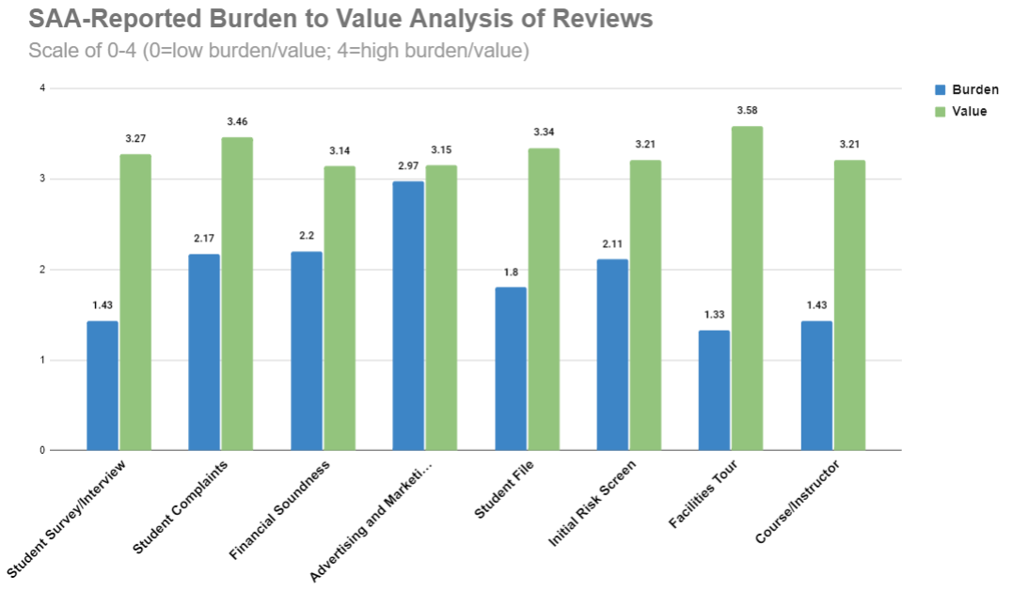
What We Learned: It Works
Risk-based quality assurance would be a more impactful and cost-effective model
Strong support from the participating SAAs
Reviews identified areas of concern
Schools generally provided information in a timely manner
SAAs appreciated the ability to take a more comprehensive approach to review
Referrals to other agencies is new to most SAAs; they will need to build relationships with accreditors and other regulators
This model is scalable and replicable
It saves time and money for low-risk facilities

Slide 21
Response from the Pilot SAAs
The only parties that had first-hand accounts of the way the old process works and the new pilot model are the six pilot SAAs—and their feedback was overwhelmingly positive
This will be important in convincing other state actors, regulators, and oversight bodies to pursue a similar model, given that their peer regulators are such positive advocates of this type of model
“This new type of review where we examine a wider range of data and information has resulted in me having conversations with the schools I oversee that I have never had before.”
“When I think about compliance surveys compared to the new risk-based process, it felt like I had blinders on that I’ve finally been able to take off.”
One school noted that questions asked were unlike accreditation—in a good way—and we looked at areas that are not covered in other reviews.
During this review risk-based surveys uncovered areas of concern that would not have been discovered in a compliance survey and highlighted best practices that served students well. Concerns were addressed by technical assistance on site or referred to other state/federal agencies.

Slide 22
Impact and Next Steps
Plans are to work with our VA partners to scale this model nationally so it is ready for national rollout in October 2022.
A national database also needs to be prepared, as required by law to house RBS findings.
SAAs required under law (October 2022) to no longer conduct compliance surveys, just risk based reviews; the pilot model and data evaluated fully comply with new statutory requirements spelled out in Isakson and Roe.
Failure to cooperate with an SAA’s request for information is grounds for disapproval.
Training and technical assistance will prepare SAAs and institutions. We are excited to execute the model this fall.
Other federal agencies and state authorizers are interested in this model.

Slide 23
Questions?

