Slide 1
VA Debt Management Center
(DMC)
School Certifying Official Training
Updated March 8, 2022
LESSONS LEARNED

Slide 2
Learning Objectives
Upon completion of this module, you should be able to:
1.
Provide an overview of DMC
Assess why/how debts are established
2.
3.
Define collection processes
4.
List options to resolve a debt
5.
Define risks of non-payment
6.
Formulate responses to debt questions
2

Slide 3
DMC Overview
DMC Mission:
Provide distinctive, high quality accounts receivable services through a compassionate and value-added approach, empowering our stakeholders to focus on core missions.
1
DMC is a franchise fund aligned with VA’s Office of Finance (OF) within the Office of Management (OM)
2
DMC’s staff of approximately 360 employees works to service VA benefit debts, counsel Veterans on options and outcomes, and offer resolutions for each unique situation.
3
DMC provides accounts receivable services to VBA, VHA, NCA
4
The DMC collects approximately $1.8 billion annually
3

Slide 4
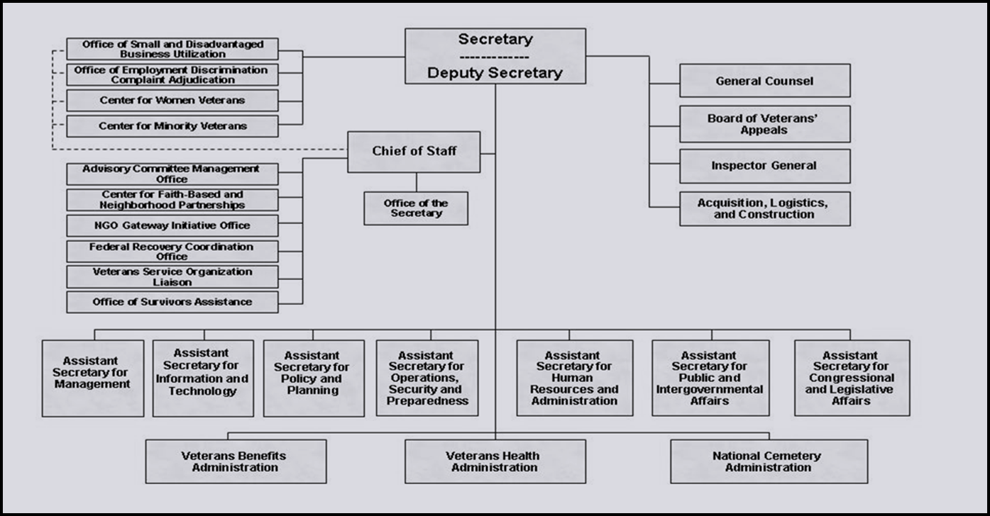
Organization Chart
4

Slide 5
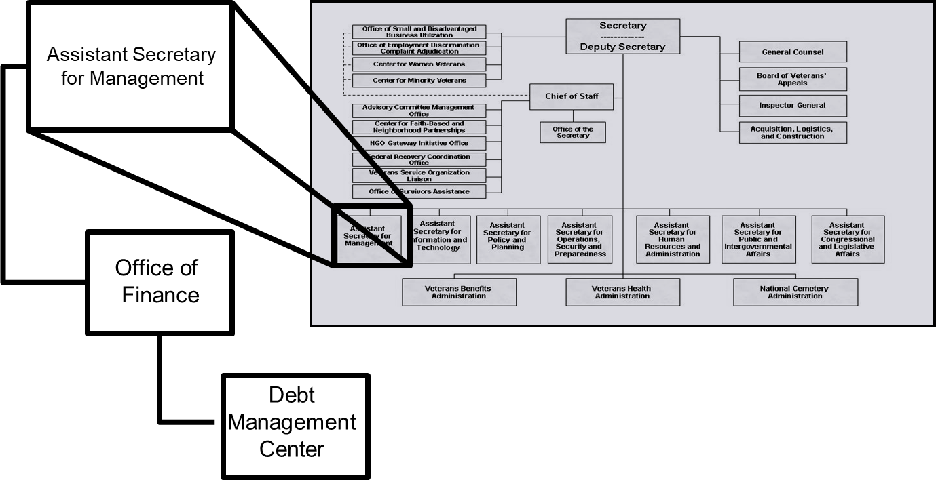
Organization Chart
5

Slide 6
DMC provides accounts receivable services to
VBA
VHA
NCA
All the above
KNOWLEDGE
CHECK
6

Slide 7
DMC provides accounts receivable services to
VBA
VHA
NCA
All the above
KNOWLEDGE
CHECK
7

Slide 8
Debt Establishment
SCO Certifies Student
RPO Processes Certifications
DMC Collects Debts
Sends collection letters for debts
Sends a letter when payments are issued or debt created
Processes collection actions
Evaluates entitlement
Issues payments and establishes debts
Communicates with student about certification process
8

Slide 9
Debt Establishment
Education and Training Institutions
Schools are financially responsible for benefits paid under the Post 9/11 GI Bill:
Tuition and fees
Yellow Ribbon Program
Students
Students will receive VA debts for:
Books and Supplies
Housing Stipend/Kicker
9

Slide 10
Debt Management Reminders
DMC can provide debt lists by facility code upon request
In order to minimize debts, schools are encouraged to use the best practice of certifying $0 tuition and fees before the term begins (allowing student to receive books and housing on time) and then certifying the Tuition/Fees/Yellow Ribbon amount at a later date
10

Slide 11
Section 1019- FAQ
Q: This debt is for a term prior to January 5, 2021, why is it still being established for the school under the section 1019 rules?
A: Debt establishment is based on the creation date of the debt, term dates are not a factor
Q: Can you share a formula or teach us how to calculate how much the debt will be when the student reduces?
A: DMC does not establish debts. RPO calculations can include the 6-credit exclusion and/or mitigating circumstances when applicable
11

Slide 12
What is the effective date of the law requiring schools to be financially responsible for benefits paid under the Post-9/11 GI Bill for tuition and fees and/or the Yellow Ribbon program?
January 5, 2021
August 1, 2021
January 5, 2022
None of the above
KNOWLEDGE
CHECK
12

Slide 13
What is the effective date of the law requiring schools to be financially responsible for benefits paid under the Post-9/11 GI Bill for tuition and fees and/or the Yellow Ribbon program.
January 5, 2021
August 1, 2021
January 5, 2022
None of the above
KNOWLEDGE
CHECK
13

Slide 14
Resuming Debt Notifications- Students
DMC resumed sending debt letters to Veterans on October 1, 2021
Phased release for debts created between April 2020 & October 2021
Veterans in later phases will receive quarterly informational letters
DMC resumed benefit offsets in January 2022
DMC will not resume referrals to Credit Reporting Agencies or Credit Alert Verification Reporting System (CAIVRS) until 2022
U.S. Department of the Treasury activity resumed October 1, 2021 for debts under their jurisdiction prior to the pandemic
DMC will not refer new VBA Veteran/Student debts to Treasury until July 2022
14

Slide 15
Debt Relief Options- Students
If Veterans/students are experiencing financial hardship, DMC is providing continued relief options:
Extending repayment plans
Requesting debt forgiveness through the waiver process
Submitting a compromise offer to settle the debt for less than the full amount
Requesting a temporary hardship suspension of repayment until September 30, 2022
15

Slide 16
Resuming Collection Activities - Schools
Schools have been receiving DMC debt notification letters, no change
Referrals to the Treasury Offset Program were not paused for schools
U.S. Department of the Treasury activity resumed October 1, 2021 for debts under their jurisdiction
16

Slide 17
VA Debt Portal for Veterans
Debt Portal: https://www.va.gov/manage-va-debt/
Veterans can log in to view balances and DMC letters
FAQ’s
Email notifications to Veterans
More enhancements to come
17

Slide 18
Outreach and Updates
VSO, SCO and Veteran emails (VetResources, VA Benefits Newsletter)
Borne the Battle Podcast
VAntage Point Blog
VA launches user-friendly online financial status report form for VBA debts
VA social media
Did you know VA has a social media directory?
Press releases
February 2, 2021: VA Establishes new Threshold for Reporting Benefit and Medical debt
18

Slide 19
DMC School Official Debt Line
833-720-2574 (international 612-843-6508)
Use for questions on Post 9/11 GI Bill Tuition and Fees debts such as:
Term dates for a debt
Confirm a payment was received
Confirm an outstanding balance
Assistance with an online payment
Disputes regarding the existence or amount of the debt should be sent via https://ask.va.gov/ (Select category: “Veterans Affairs-Debt” and topic: “A School Official”)
19

Slide 20
School Debt Collection Process
DMC sends Notice of Indebtedness letters, monitors accounts, and advises debtor of any delinquency, including the requirement to refer their account to Treasury
DMC Sends 1st Letter
30 days
DMC Sends 2nd Letter
30 days
DMC Sends 3rd Letter
60 days
Debt is Referred to Treasury (120 days)
If DMC receives payment, next collection letter is deferred
20

Slide 21
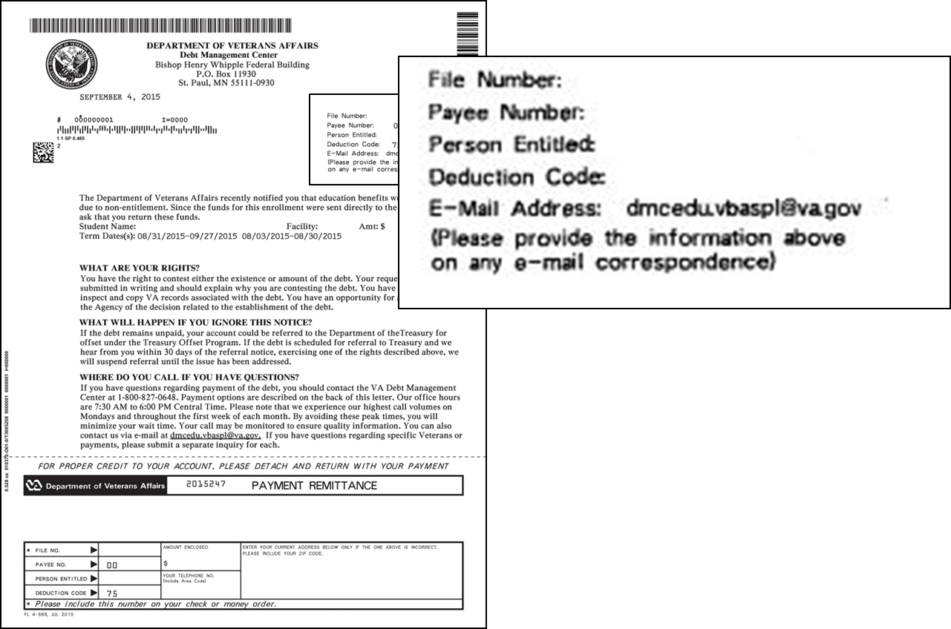
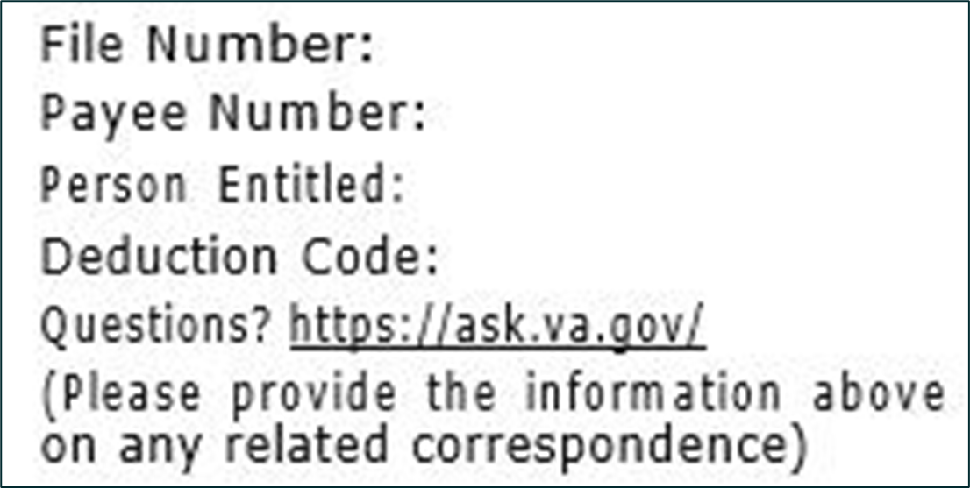
Notification Letters
21

Slide 22
When does DMC refer a debt to the Department of Treasury?
30 days after the third letter is sent
60 days after the third letter is sent
90 days after the third letter is sent
120 days after the third letter is sent
KNOWLEDGE
CHECK
22

Slide 23
When does DMC refer a debt to the Department of Treasury?
30 days after the third letter is sent
b. 60 days after the third letter is sent
90 days after the third letter is sent
120 days after the third letter is sent
KNOWLEDGE
CHECK
23

Slide 24
School Options
School Options
Pay in Full
Dispute
Compromise
Payment Plan
24

Slide 25
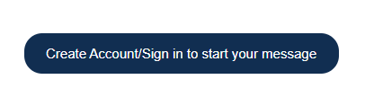
Ask VA (AVA) for School Inquiries
All school inquiries and disputes should be submitted using AVA (https://ask.va.gov/)
Select “Veterans Affairs- Debt” as the category and “A School Official” as the topic
Under “My inquiry is” select “On behalf of a Veteran”- this enables you to select School Certifying Official or Other (Business) under relationship to Veteran
You must log in to receive a response that receives specific debt information
25

Slide 26
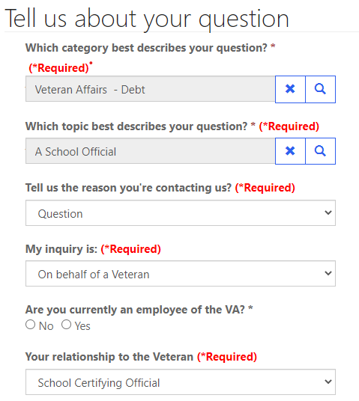
Ask VA (AVA) for School Inquiries
Veterans Affairs- Debt
A School Official
Question
On behalf of a Veteran
School Certifying Official
26

Slide 27
Tips for School Inquiries
When submitting disputes and inquiries via AVA, please include:
One inquiry per student
Identifying information for the student
School name and facility code
Debt amount
Supporting details (front and back of cashed check, when was updated certification sent, etc.)
27

Slide 28
Which of the following is not an option for schools regarding a debt?
Pay in full
Compromise
Request a waiver of the debt
Dispute the debt
KNOWLEDGE
CHECK
28

Slide 29
Which of the following is not an option for schools regarding a debt?
Pay in full
Compromise
c. Request a waiver of the debt
Dispute the debt
KNOWLEDGE
CHECK
29

Slide 30
Student Options
Student Options
Pay in Full
Dispute
Payment Plan
Waiver
Reduced Benefit Offset
Compromise
30

Slide 31
What actions can a student take if he or she incurs a debt
Pay in full
Request a waiver of the debt
Compromise
Set up a payment plan
All of the above
KNOWLEDGE
CHECK
31

Slide 32
What actions can a student take if he or she incurs a debt
Pay in full
Request a waiver of the debt
Compromise
Set up a payment plan
e. All the above
KNOWLEDGE
CHECK
32

Slide 33
How to Pay a Debt
Pay by check: mail the check, payment coupon(s) and/or letter to:
VA Debt Management Center
Bishop Henry Whipple Federal Building
P.O. Box 11930
St. Paul, MN 55111-0930
Pay online: www.pay.va.gov
Check SCO handbook for other options
33

Slide 34
Toolbox
Reduced repayment plans
Expedite hardship refunds
Temporarily suspend offset
Prioritize waiver requests
34

Slide 35
Federal Debt Collection Laws
The Debt Collection Act of 1982
Authority for collection by administrative offset
The Debt Collection Improvement Act (DCIA) of 1996
Agencies required to refer delinquent non-tax debts to the Department of Treasury at 180 days
Digital Accountability and Transparency Act (DATA) of 2014
Changed referral requirement for delinquent non-tax debts from 180 days to 120 days
35

Slide 36
Treasury Overview Debt Collection Tools
Treasury has two main programs for student and school debt collection
Treasury Offset Program (TOP)
Cross-Servicing (CS)
Federal grants
Social Security
Civilian pay
Military retirement
Private Collections Agencies (PCA)
Telephone collections
Administrative Wage Garnishment (AWG)
36

Slide 37
How to Contact TOP
Schools may contact TOP by calling the TOP Call Center:
1-800-304-3107
In order to provide you with information about an offset, Treasury will need to know:
The caller’s name, department and job title. The job title will need to indicate a need-to-know position
At least one of the following:
date of the payment
amount of the original payment
amount of the offset
Make sure to obtain the Debt Account ID related to the offset from Treasury (typically ends in 0075 for school tuition) before contacting DMC about an offset
37

Slide 38
What are the two main programs used by the Department of Treasury to collect school and student debts?
TOP and CRA
CAIVRS and DMC
TOP and CS
None of the above
KNOWLEDGE
CHECK
38

Slide 39
What are the two main programs used by the Department of Treasury to collect school and student debts?
TOP and CRA
CAIVRS and DMC
c. TOP and CS
d. None of the above
KNOWLEDGE
CHECK
39

Slide 40
Become a Debt Superstar (Contact DMC)
https://www.va.gov/manage-va-debt/ | Veteran Debt Portal
https://ask.va.gov | Online inquiry system (subject: Veterans Affairs- Debt, topic: A School Official)
833-720-2574 | DMC School Official Debt Line
800-827-0648 | DMC Toll Free Line - Students
40

Slide 41
Issue Not Getting Resolved?
Julie Lawrence – Chief Education and External Relations
Julie.Lawrence@va.gov
Nicole Haselberger – Assistant Chief Education and External Relations
Nicole.Haselberger@va.gov
Tami Dorle – Supervisory Financial Administrative Specialist
Tamara.Dorle@va.gov
Gary Greenwood – Management Analyst
Gary.Greenwood2@va.gov
41

Slide 42
Summary
You should now be able to:
1.
Provide an overview of DMC
Assess why/how debts are established
2.
3.
Define the collection processes
4.
List options to resolve a debt
5.
Define risks of non-payment
6.
Formulate responses to debt questions
42

Slide 43
DMC Presentation Survey
DMC values your time and feedback on our presentation. We would appreciate it if you’re able to complete the survey below.
https://www.surveymonkey.com/r/DMCSCO
43

Slide 44
How to Self-Certify
Click on the URL or copy and paste it in your web browser.
https://vba-tpss.vbatraining.org/assess/trkSignIn?refid=XSCO
2. Enter your email address and eight (8) digit facility code and click Next
(If you do not have a user profile, click New User Account and follow the steps to set up your profile.)
3. Scroll down and click the Conference/Workshop/Virtual Training tab
4. Select the applicable training session from the list of topics that appears on the right side of the screen by clicking Begin
5. To enter Conference/Workshop/Virtual Training Title: Click the dropdown arrow and select SCO Virtual Training Session and click Submit
6. Enter the start date and the end date
7. Enter your Facility Name, City and State (Main Campus) and click Submit
8. Certify your attendance by clicking Agree and then submit.
9. Print your training certificate and keep for your records
44

Slide 45
Questions

