Slide 1


VA Debt Management Center
(DMC)
School Certifying Official Training
Updated March 1, 2023
LESSONS LEARNED

Slide 2

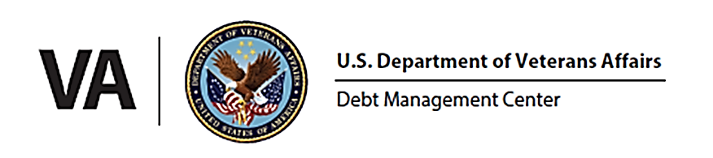
Learning Objectives
Upon completion of this module, you should be able to:
1.
Provide an overview of DMC
Assess why/how debts are established
2.
3.
Define collection processes
4.
List options to resolve a debt
5.
Define risks of non-payment
6.
Formulate responses to debt questions
2

Slide 3
DMC Overview
DMC Mission:
Provide distinctive, high quality accounts receivable services through a compassionate and value-added approach, empowering our stakeholders to focus on core missions.
1
DMC is a franchise fund aligned with VA’s Office of Finance (OF) within the Office of Management (OM)
2
DMC’s staff of approximately 320 employees works to service VA benefit debts, counsel Veterans on options and outcomes, and offer resolutions for each unique situation.
3
DMC provides accounts receivable services to VBA, VHA, NCA
4
The DMC collects approximately $1.8 billion annually
3

Slide 4
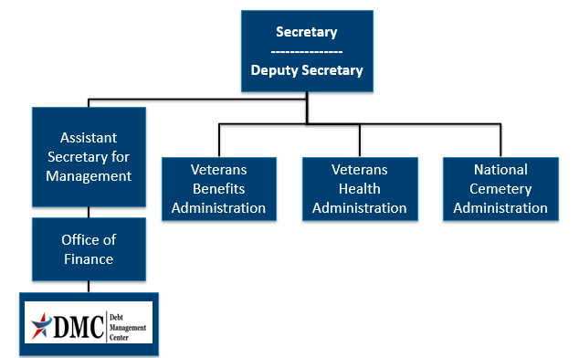
Organization Chart
4
4

Slide 5
DMC provides accounts receivable services to
VBA
VHA
NCA
All the above
KNOWLEDGE
CHECK
5

Slide 6
DMC provides accounts receivable services to
VBA
VHA
NCA
All the above
KNOWLEDGE
CHECK
6

Slide 7
Debt Establishment
SCO Certifies Student
RPO Processes Certifications
DMC Collects Debts
Sends collection letters for debts
Sends a letter when payments are issued or debt created
Processes collection actions
Evaluates entitlement
Issues payments and establishes debts
Communicates with student about certification process
7

Slide 8
Debt Establishment
Education and Training Institutions
Schools are financially responsible for benefits paid under the Post 9/11 GI Bill:
Tuition and fees
Yellow Ribbon Program
Students
Students will receive VA debts for:
Books and Supplies
Housing Stipend/Kicker
8

Slide 9
Debt Establishment Reasons
Student never attended any classes
(All tuition/fees/YR)
Student completely withdrew on or before first day of term
(All tuition/fees/YR)
Payment for wrong student, duplicate payment (Erroneous amount)
Payment above certified amount due to VA data entry error (Erroneous amount)
Reporting reduced tuition and fees and/or Yellow Ribbon amounts
(Amount of $ change if nothing else changed)
Student dropped/added a course with no net change in training time caused change to tuition, fees, and/or Yellow Ribbon amount
(Amount of $ change)
9

Slide 10
Debt Establishment Reasons
Student withdrew after the first day of the term
Student reduced hours before or during term
School reported a reduction in tuition, fees, and/or Yellow Ribbon due to student reducing or terminating training
10

Slide 11
Debt Establishment Reasons
Reductions and terminations
During a school’s drop period will be effective the end of the month during which the reduction occurred or the actual date of withdrawal.
For which punitive grades are assigned will be effective the end of the month during which the reduction occurred or the actual date of withdrawal.
After the drop period for which non-punitive grades are assigned will be effective the first day of the term unless:
  The 6-credit hour exclusion is granted
  Mitigating circumstances (MIT-C) exist
11

Slide 12
Preventing School Debts
Communication with students about the impact of the following:
  Reducing training
  Receiving non-punitive grades
  Changing their class schedule
12

Slide 13
Preventing School Debts
When non-punitive grades occur:
School can include mitigating circumstances on certification (if provided)
Student can submit mitigating circumstances to the Regional Processing Office to potentially reduce the amount of debt created
Certify $0 tuition and fees before the term begins (allowing student to receive books and housing on time) and then certifying the Tuition/Fees/Yellow Ribbon amount at a later date
13

Slide 14
COVID-19 Operations- Students
DMC plans to resume Treasury referrals of delinquent VBA Veteran/Student debts, date is still TBD
DMC has not resumed referrals to Credit Reporting Agencies or Credit Alert Verification Reporting System (CAIVRS) at this time (resumption date TBD)
14

Slide 15
Debt Relief Options- Students
If Veterans/students are experiencing financial hardship, DMC has relief options available:
Extending repayment plans
Requesting debt forgiveness through the waiver process
Submitting a compromise offer to settle the debt for less than the full amount
Requesting a temporary suspension
15

Slide 16
VA Debt Portal for Veterans
    Debt Portal: https://www.va.gov/manage-va-debt/
      Veterans can log in to view balances
      FAQ’s
      Email notifications to Veterans
      Online VA Form 5655 Financial Status Report (FSR)
      More enhancements to come
16

Slide 17
Outreach and Updates
VSO, SCO and Veteran emails (VetResources, VA Benefits Newsletter)
Borne the Battle Podcast
VAntage Point Blog
  Five ways VA is making debt collection more compassionate and convenient
VA social media
  Did you know VA has a social media directory?
Press releases
  September 30, 2022: VA offers benefit debt relief to Veterans affected by recent hurricanes
17

Slide 18
DMC School Official Debt Line
    833-720-2574 (international 612-843-6508)
    Use for questions on Post 9/11 GI Bill Tuition and Fees debts such as:
      Term dates for a debt
      Confirm a payment was received
      Confirm an outstanding balance
      Assistance with an online payment
    Disputes regarding the existence or amount of the debt should be sent via https://ask.va.gov/ (Select category: “Veterans Affairs-Debt” and topic: “A School Official”)
18

Slide 19
School Debt Collection Process
DMC sends Notice of Indebtedness letters, monitors accounts, and advises debtor of any delinquency, including the requirement to refer their account to Treasury
DMC Sends 1st Letter
30 days
DMC Sends 2nd Letter
30 days
DMC Sends 3rd Letter
60 days
Debt is Referred to Treasury (120 days)
If DMC receives payment, next collection letter is deferred
19

Slide 20
When does DMC refer a debt to the Department of Treasury?
30 days after the third letter is sent
60 days after the third letter is sent
90 days after the third letter is sent
120 days after the third letter is sent
KNOWLEDGE
CHECK
20

Slide 21
When does DMC refer a debt to the Department of Treasury?
30 days after the third letter is sent
b. 60 days after the third letter is sent
90 days after the third letter is sent
120 days after the third letter is sent
KNOWLEDGE
CHECK
21

Slide 22
School Options
School Options
Pay in Full
Dispute
Compromise
Payment Plan
22

Slide 23
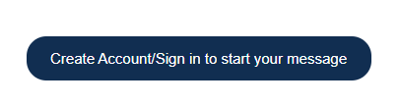
Ask VA (AVA) for School Inquiries
All school inquiries and disputes should be submitted using AVA (https://ask.va.gov/)
Select “Veterans Affairs- Debt” as the category and “A School Official” as the topic
Under “My inquiry is” select “On behalf of a Veteran”- this enables you to select School Certifying Official or Other (Business) under relationship to Veteran
You must log in to receive a response that receives specific debt information
23

Slide 24
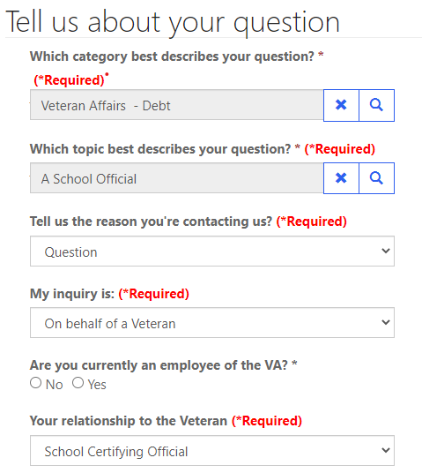
Ask VA (AVA) for School Inquiries
Veterans Affairs- Debt
A School Official
Question
On behalf of a Veteran
School Certifying Official
24

Slide 25

Requesting a debt list in Ask VA (AVA)
DMC can provide debt lists by facility code upon request
Since the debt list is not associated with one specific Veteran, you can choose general question to submit your debt list by facility code request (you must still be signed in to AVA)
25

Slide 26
Tips for School Inquiries
When submitting disputes and inquiries via AVA, please include:
One inquiry per student
Identifying information for the student
School name and facility code
Debt amount
Supporting details (front and back of cashed check, when was updated certification sent, etc.)
26

Slide 27

How to Pay a Debt
Pay by check: mail the check, payment coupon(s) and/or letter to:
    VA Debt Management Center
    Bishop Henry Whipple Federal Building
    P.O. Box 11930
    St. Paul, MN 55111-0930
Pay online: www.pay.va.gov
Check SCO handbook for other options
27

Slide 28
Which option(s) should schools select to contact DMC in AVA?
Veterans Affairs- Debt
A School Official
Education
A and B
KNOWLEDGE
CHECK
28

Slide 29
Which option(s) should schools select to contact DMC in AVA?
Veterans Affairs- Debt
A School Official
Education
A and B
KNOWLEDGE
CHECK
29

Slide 30

Student Options
Student Options
Pay in Full
Dispute
Payment Plan
Waiver
Reduced Benefit Offset
Compromise
Temporary Suspension
30

Slide 31
What actions can a student take if he or she incurs a debt
Pay in full
Request a waiver of the debt
Compromise
Set up a payment plan
All of the above
KNOWLEDGE
CHECK
31

Slide 32
What actions can a student take if he or she incurs a debt
Pay in full
Request a waiver of the debt
Compromise
Set up a payment plan
e. All the above
KNOWLEDGE
CHECK
32

Slide 33
Federal Debt Collection Laws
The Debt Collection Act of 1982
  Authority for collection by administrative offset
The Debt Collection Improvement Act (DCIA) of 1996
  Agencies required to refer delinquent non-tax debts to the Department of Treasury at 180 days
Digital Accountability and Transparency Act (DATA) of 2014
  Changed referral requirement for delinquent non-tax debts from 180 days to 120 days
33

Slide 34
Treasury Overview Debt Collection Tools
Treasury has two main programs for student and school debt collection
Treasury Offset Program (TOP)
Cross-Servicing (CS)
Federal grants
Social Security
Civilian pay
Military retirement
Private Collections Agencies (PCA)
Telephone collections
Administrative Wage Garnishment (AWG)
34

Slide 35
How to Contact TOP
Schools may contact TOP by calling the TOP Call Center:
1-800-304-3107
In order to provide you with information about an offset, Treasury will need to know:
The caller’s name, department and job title. The job title will need to indicate a need-to-know position
At least one of the following:
  date of the payment
  amount of the original payment
  amount of the offset
Make sure to obtain the Debt Account ID related to the offset from Treasury (typically ends in 0075 for school tuition) before contacting DMC about an offset
35

Slide 36
What are the two main programs used by the Department of Treasury to collect school and student debts?
TOP and CRA
CAIVRS and DMC
TOP and CS
None of the above
KNOWLEDGE
CHECK
36

Slide 37
What are the two main programs used by the Department of Treasury to collect school and student debts?
TOP and CRA
CAIVRS and DMC
c. TOP and CS
d. None of the above
KNOWLEDGE
CHECK
37

Slide 38

Become a Debt Superstar (Contact DMC)
https://www.va.gov/manage-va-debt/ | Veteran Debt Portal
https://ask.va.gov | Online inquiry system (subject: Veterans Affairs- Debt, topic: A School Official)
833-720-2574 | DMC School Official Debt Line
800-827-0648 | DMC Toll Free Line - Students
38

Slide 39

Issue Not Getting Resolved?
Julie Lawrence – Chief Education and External Relations
Julie.Lawrence@va.gov
Nicole Haselberger – Assistant Chief Education and External Relations
Nicole.Haselberger@va.gov
Tami Dorle – Supervisory Financial Administrative Specialist
Tamara.Dorle@va.gov
Gary Greenwood – Management Analyst
Gary.Greenwood2@va.gov
39

Slide 40

Summary
You should now be able to:
1.
Provide an overview of DMC
Assess why/how debts are established
2.
3.
Define the collection processes
4.
List options to resolve a debt
5.
Define risks of non-payment
6.
Formulate responses to debt questions
40

Slide 41
How to Self-Certify
Click on the URL or copy and paste it in your web browser.
https://vba-tpss.vbatraining.org/assess/trkSignIn?refid=XSCO
2. Enter your email address and eight (8) digit facility code and click Next
    (If you do not have a user profile, click New User Account and follow the steps to set up your profile.)
3. Scroll down and click the Conference/Workshop/Virtual Training tab
4. Select the applicable training session from the list of topics that appears on the right side of the screen by clicking Begin
5. To enter Conference/Workshop/Virtual Training Title: Click the dropdown arrow and select SCO Virtual Training Session and click Submit
6. Enter the start date and the end date
7. Enter your Facility Name, City and State (Main Campus) and click Submit
8. Certify your attendance by clicking Agree and then submit.
9. Print your training certificate and keep for your records
41

Slide 42
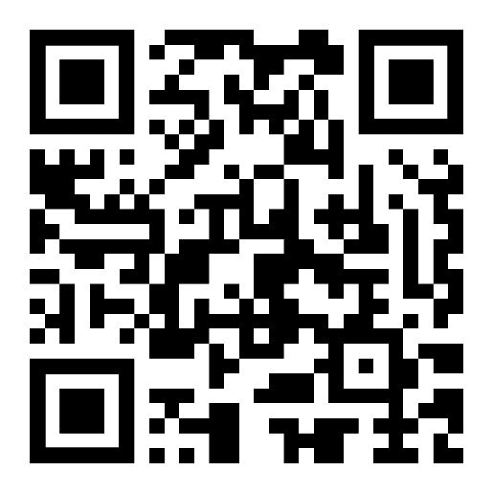
DMC Presentation Survey
DMC values your time and feedback on our presentation. We would appreciate it if you’re able to complete the survey below.
  https://www.surveymonkey.com/r/DMCSCO
42

