Slide 1
Federal Tuition Assistance
Mr. John Berube SC ARNG ESS

Slide 2
Thank you!

Slide 3
Federal TA
Who: all Army personnel
What: Not an entitlement; subject to service member eligibility. May be used towards academic degrees - associate’s, bachelor’s, and master’s level; technical, occupational and continuing educational certificates.
How much: Up to $250.00 per semester hour for a max of 16 SH per fiscal year
Where: Eligible schools must have DoD Memorandum of Record; may be public or private
Website for access: https://aiportal.us.af.mil/aiportal/Account/Login
POC for NC: Mrs. Sherrita Ried sherrita.l.ried.civ@army.mil / (919) 605-5143

Slide 4
Available Resources to Service Members
DANTES Home Page https://www.dantes.doded.mil

Slide 5
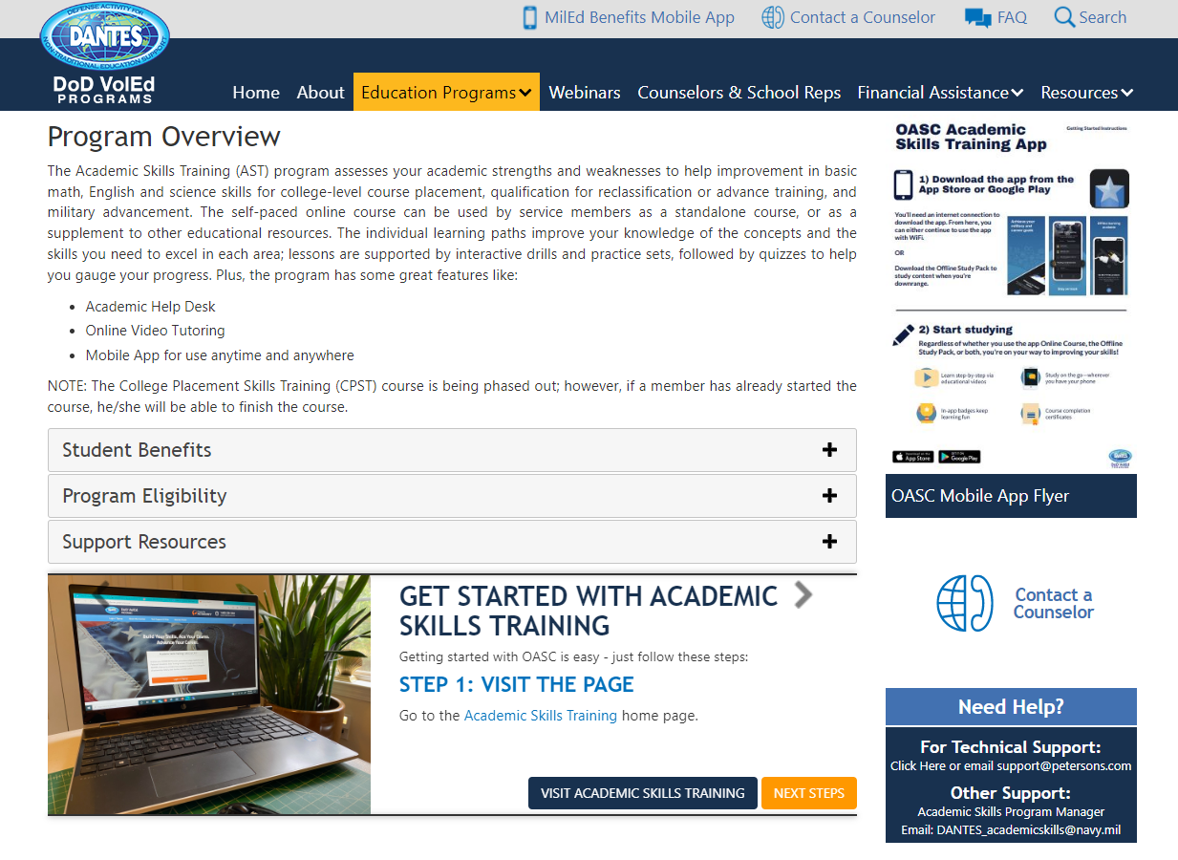
Available Resources to Service Members
DANTES Home Page https://www.dantes.doded.mil

Slide 6
ArmyIgnitED School Support
https://vantagepoint-inc.com/armyschoolsupport

Slide 7
BAM Helpdesk Contact Info
Helpdesk Phone Number: 276-231-0938
Helpdesk Email: army@bamtech.net

Slide 8
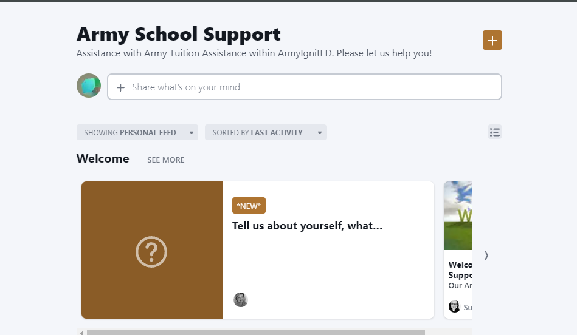
School Support Knowledge Community
What Is It?
A collaboration channel that enables
AIs to support and respond to each other
School Support will also provide tips
of the day and other guidance
How Do I Access It?
Must have an.edu email address
Go to: https://military-school-support.mn.co/

Slide 9
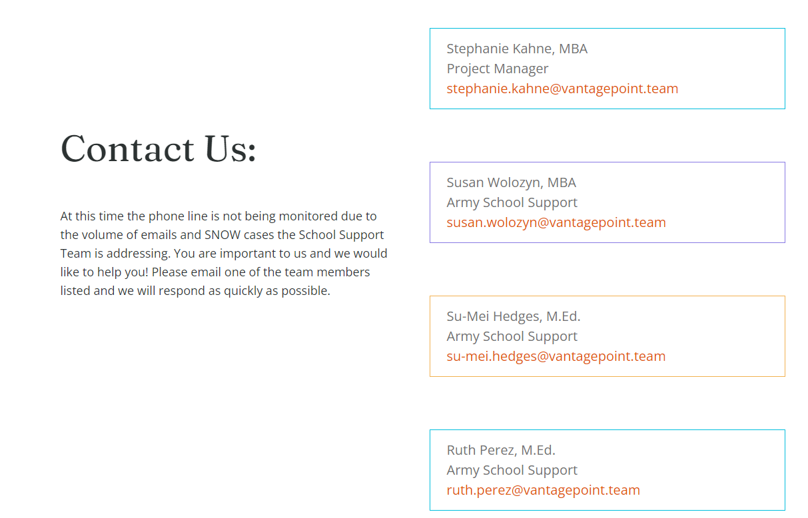
School Support POCs

Slide 10
Things to Remember
Students can not request TA after class has started. The last chance for funding requests is 7 days prior to class. If the student has an issue have them contact the Education Services Office for assistance.
Make sure that school contact information, degrees, and courses are up to date in the system
Being a TA approved school does not make you automatically approved for CA. Your school will need to become an approved Vendor

Slide 11
Things to Remember
TA is the initial payor for military related funding, so GI Bill and state military tuition is based on remaining tuition and/or fee remaining.
Refunds of TA to students is not authorized. All overpayments are to be returned to the Army via check. Please follow the refund steps within the AI portal

Slide 12
Events
Mrs. Sherrita Ried NC ARNG ESS will be hosting an AI Portal training on April 5th, 2023 at 9:30am-11:30am via MS Teams please email her at sherrita.l.ried.civ@army.mil for an invite
If you would like Mrs. Ried to visit your school to assist your office, discuss programs and/or to assist students please email or call (919) 605-5143

