Slide 1
Veteran Readiness
& Employment
(Formerly Vocational Rehabilitation & Employment)

Slide 2
Veteran Readiness & Employment: What is It?
Isn’t VR&E really a GI Bill program for service-disabled Veterans?
No. GI Bill is an educational benefits program. VR&E may provide education, but always as a means to achieve suitable employment.
  The “E” in VR&E stands for the program’s mission to assist Veterans and Servicemembers with obtaining suitable Employment (not Education).
  Four of the five VR&E service categories are geared toward employment with personalized employment services offered (e.g., work readiness preparation, resume development, job-seeking skills, job accommodations, placement assistance, post-employment follow-up, etc.).
What is Veteran Readiness & Employment (VR&E)?
Primary Focus - Pathway to suitable employment and career stability for entitled Veterans and Servicemembers with service-connected disabilities.
Secondary Focus - Increased independence in daily living for Veterans currently unable to work.

Slide 3
Qualifying for VR&E: Veterans
All service-disabled Veterans can receive services through VR&E, correct?
No. To receive VR&E services, Veterans must be found eligible and entitled.
Eligibility to open a claim:
  Honorable or other than dishonorable discharge
  A VA service-connected disability rating of 10% or more; or memorandum rating of 20%
  Submit application at Veteran Readiness And Employment (Chapter 31) | Veterans Affairs (va.gov)
Entitlement to VR&E services is the claims decision made by Vocational Rehabilitation Counselor (VRC):
  Veteran has barriers to employability
  The barriers are due substantially to his/her service-connected disability conditions
  The Veteran must not have overcome the barriers by being suitably and stably employed or by having training/education/skills needed to qualify for suitable employment.
  For a Veteran rated 10%, additional criteria must be met (Serious Employment Handicap)

Slide 4
VR&E Basic Eligibility Period
The law generally provides 12-year period of eligibility, beginning on the latter of these dates:
  Date of separation from active duty
  Date the Veteran was first notified of a compensable service-connected disability rating
  Effective 01/05/2021, the 12-year eligibility period of eligibility does not apply to claimants who were discharged on or after January 1, 2013

Slide 5
VR&E Five Service Tracks
Re-employment
  Active Duty/Guard/Reservists requiring assistance to return to a previous employer
    Consultation with employers, job accommodations, re-employment rights advice, case management
Rapid Access to Employment
  Veterans with established skills & education in need of immediate employment assistance
    Resume development, job search assistance, placement services, post-employment follow-up
Employment through Long-Term Services
  Veterans requiring skills training in order to obtain suitable employment
    Internships/apprenticeships, On-the-Job Training, college/vocational/technical training; coverage of tuition, fees, books, supplies; monthly subsistence allowance; case management
Self-Employment
  Assist Veterans who have the desire and skills to start and operate a business
    Help developing a business plan, analysis of business concept, training in small business operations/marketing/finances, and guidance in obtaining resources to implement the business plan
Independent Living
  Reserved for those not ready for employment, but in need of services to be more independent at home & in the community
    Acquiring assistive technology, independent living skills training, community-based support services, gaining increased access within the home and community

Slide 6
VR&E Services and Benefits
Wide array of services tailored to the individual, depends on needs and service track: vocational evaluation, career guidance and counseling, training/education, independent living, self-employment, employment assistance, etc.
Variety of training programs (college, trade school, certifications/licensure, OJT, NPWE, apprenticeship)
  Payment of tuition, fees, books, required supplies plus a monthly subsistence allowance
  Monthly allowance can be paid at the Post-9/11 GI Bill rate or BAH if eligible
Individualized case management with Vocational Rehabilitation Counselor (VRC)
  VRCs facilitate career planning, labor market analysis, coordination of medical referrals, and support to achieve successful completion of training and suitable employment.
  Employment Coordinators assist with job-seeking skills and placement.
Expanded medical care at VA Medical Centers (medical, dental, vision care) – especially relevant for Veterans who do not qualify for all services based on disability rating.

Slide 7
VR&E Claim Progression
Apply
Initial Evaluation
Entitlement Determination
Plan Development
Plan Service Delivery
Employment Services
Suitable Employment

Slide 8
Authorization and Invoicing
  Authorizations
Authorizations are submitted to the training facility after a Vocational Rehabilitation Counselor (VRC) has received a signed plan from the Veteran and notifies the training facility that a Veteran is approved by the VA to attend and that VA is responsible for payment of tuition, fees, books and supplies
Always check to ensure the program information on the authorization matches the training program at the facility- Programs must be approved by the VRC before a Veteran can start or change their program (this includes minors and focus areas) – When in doubt always refer the Veteran to their VRC
Invoices
Invoices must include an itemized break down of all fees and charges and include the Veteran’s signature for receipt of books and supplies
Tungsten Support- Phone: 1-877-489-6135
VA Financial Services Center- Phone: 1-877-353-9791 Email: vafsccshd@va.gov

Slide 9
Credit Memo Process
Credit memos must be submitted by the facility using IPPS via Tungsten Network
Include an itemized invoice of amount to be returned
Credit memo is routed to the VRC, who validates, accepts and sends to Support Services Division (SSD)
SSD establishes the debt and sends a collection letter to the facility
Facility receives collection letter and sends payment via check to agent cashier and includes a copy of the debt letter with the check
Once received by Agent Cashier, it will be processed and debt is then offset
Inquiries (after 20 days) regarding receipt of payment go to: SSD.VBAWIN@va.gov with a copy to Christopher Moore at christopher.t.moore@va.gov

Slide 10
Enrollment Certification Process
Enrollment Certification- can be submitted up to 120 days prior to beginning of term but no later than 30 days after term start date
Adjustments and amendments- submit as soon as possible to avoid creating a debt to the Veteran
Amendments for tuition and fees- not required for VR&E
Subsistence Allowance –
  Processed only if the facility certifies the Veteran’s training attendance via Enrollment Manager Enrollment Manager Frequently Asked Questions - Education and Training (va.gov)
  Veteran receives payment on the 1st day of following month for training in previous month
  Based on training rate of pursuit and number of days attended within the month
  CH31 Subsistence Allowance Rate- Veterans who served before 09/11/2001 and/or Post 9/11 GI Bill Rate (BAH)
  No subsistence paid for training lest than ½ time (Using VA calculations)
  VRC has 10 days to process subsistence allowance after receipt of enrollment verification (received in 24-48 hours)

Slide 11

Questions

Slide 12
VR&E Locations
Where Are We Located
  8 locations throughout North Carolina:
  Winston-Salem Regional Office
    Asheville VA Medical Center
    Salisbury VA Medical Center
    Charlotte VA Community Based Outpatient Clinic
  Fort Bragg
    Fayetteville Technical Community College
  Camp Lejeune
  Raleigh
How to Reach VR&E
  Phone: 336-714-6099
  Email: VREEMPLOYMENT.VBAWIN@va.gov

Slide 13

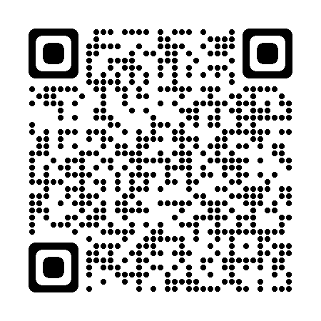
What is the PACT Act?
Vietnam
Gulf War Era
Post-9/11 Afghanistan and Iraq
The Sergeant First Class Heath Robinson
Promise to Address Comprehensive Toxics (PACT) Act of 2022
is a new law that expands VA health care and benefits for Veterans exposed to burn pits and other toxic substances. This law helps us provide generations of Veterans—and their survivors—
with the care and benefits they’ve earned and deserve.
The PACT Act :
Expands and extends eligibility for VA health care for Veterans with toxic exposures
and Veterans of the Vietnam era, Gulf War era, and Post-9/11 era.
Expands eligibility for benefits for Veterans exposed to toxic substances.

Slide 14
Gulf War Era and Post-9/11 Eligibility
If a Veteran served in any of these locations and time periods, they are eligible for the new Gulf War-related
presumptions. This includes the airspace above any of these locations.
On or After August 2, 1990:
Bahrain
Iraq
Kuwait
Oman
Qatar
Saudi Arabia
Somalia
The United Arab Emirates (UAE)
On or After September 11, 2001:
Afghanistan
Djibouti
Egypt
Jordan
Lebanon
Syria
Uzbekistan
Yemen

Slide 15
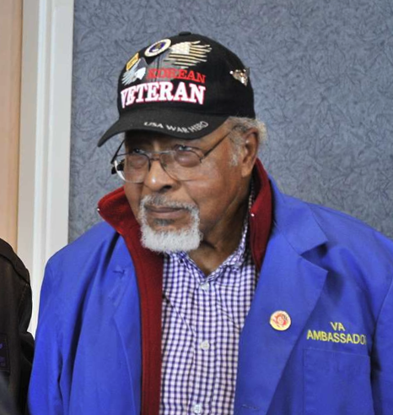
Conditions Presumed to be Service-Connected
As of August 10, 2022, a long list of new conditions are presumed to be service-connected due to various in-service toxic exposures. APPLY NOW at VA.gov/PACT to expedite your claim and benefits.
Asthma (diagnosed after service)
Brain cancer
Chronic bronchitis
Chronic obstructive pulmonary disease (COPD)
Chronic rhinitis
Chronic sinusitis
Constrictive bronchiolitis or obliterative bronchiolitis
Emphysema
Gastrointestinal cancer of any type
Glioblastoma
Granulomatous disease
Head cancer of any type
High blood pressure (hypertension)
Interstitial lung disease (ILD)
Kidney cancer
Lymphomatic cancer of any type
Lymphoma of any type
Melanoma
Monoclonal gammopathy of
undetermined significance (MGUS)
Neck cancer
Pancreatic cancer
Pleuritis
Pulmonary fibrosis
Reproductive cancer of any type
Respiratory (breathing-related)
cancer of any type
Sarcoidosis
Notes:
The full list of 23 presumptives under the law, spanning from the Vietnam Era through the Post-9/11 Era of service

Slide 16
When or How Should I File a Claim?
What if I have previously
been denied?
Veterans previously denied a toxic-exposure
related claim are encouraged to file a supplemental
claim. Once a supplemental claim is received, VA
will review the claim under the new law.
APPLY NOW!
For more info, visit VA.gov/PACT or call 1-800-MyVA411
Notes:
For the briefer, please reiterate going through the website to find the E-Z forms needed to file a claim and/or enroll in health care.

